Slide 1
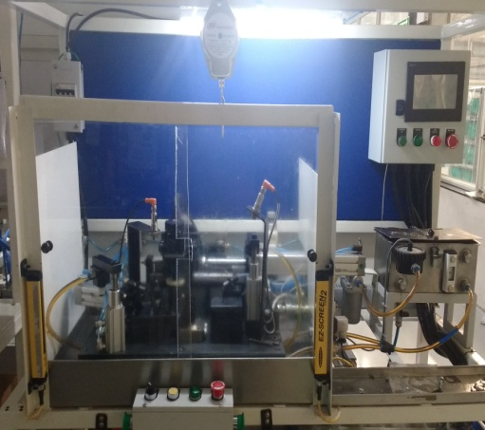
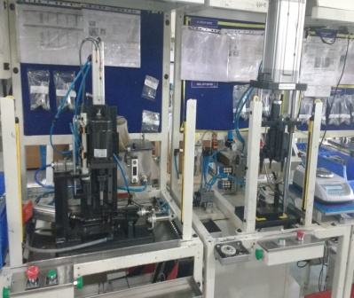
ADqIK
TPM CIRCLE NO :-
ACTIVITY
KK
QM
PM
JH
SHE
OT
DM
E&T
KAIZEN IDEA SHEET
TPM CIRCLE NAME :-
LOSS NO. / STEP
KAIZEN NO:-
DEPT :-ME
RESULT AREA
P
Q
DEF :- A / B / C
C
D
S
M
CELL :- A410
CELL NAME:-Assly. Line
MACHINE / STAGE :- Free rotation & Flushing Test Rig
Operation: Free rotation, Flushing test
KAIZEN THEME :-To reduce
manpower by combining operations.
IDEA :- To introduce Free rotation & Flushing combi
COUNTERMEASURE:- New test for free rotation
& flushing combine testing
BENCHMARK
28sec
WIDELY/DEEPLY:-
TARGET
28Sec
PROBLEM / PRESENT STATUS:- Extra
Manpower required due to both stations
are separate.
KAIZEN START
1/01/2017
KAIZEN FINISH
10/02/2017
AFTER
TEAM MEMBERS :-
Snehal, Ajay,Rakesh,Samadhan, Ajit
BEFORE
BENEFITS :-
1.Manday saved by 0.7 /month
2.Delivery achieved.
3.Productivity per manpower increased
Separate station for free rotation & Flushing.
2 operators require.
Combi machine for free rotation & Flushing.
Single operator require
KAIZEN SUSTENANCE
WHAT TO DO :- Process change
Note , PCP to be change
WHY - WHY ANALYSIS :-
Why 1-Manpower require for free rotation &
flushing is more
Why 2- separate operator require for both testing
Why 3- both testing done on separate station
RESULT : Manpower reduced by 1/shift
HOW TO DO :- Document updating
as per process
FREQUENCY :- 1 time activity
ROOT CAUSE :-
Free rotation & flushing need to be combine
COST INCURRED FOR MAKING KAIZEN
MATERIAL COST
RS.
LABOUR COST
RS.
TOTAL COST
RS.
SCOPE & PLAN FOR HORIZONTAL DEPLOYMENT
REGISTRATION NO&DATE:24/12/2016
SR.
NO.
CELL
TARGET
NA
STATUS
REGISTERED BY :- Ajay Bhor
MANAGER’S SIGN :-

